Slide 1
Self-care:
A brief conversation
Angie Muhs, LCSW, MSW
Assistant Professor, Department of Social Work
Owner, ANew

Slide 2
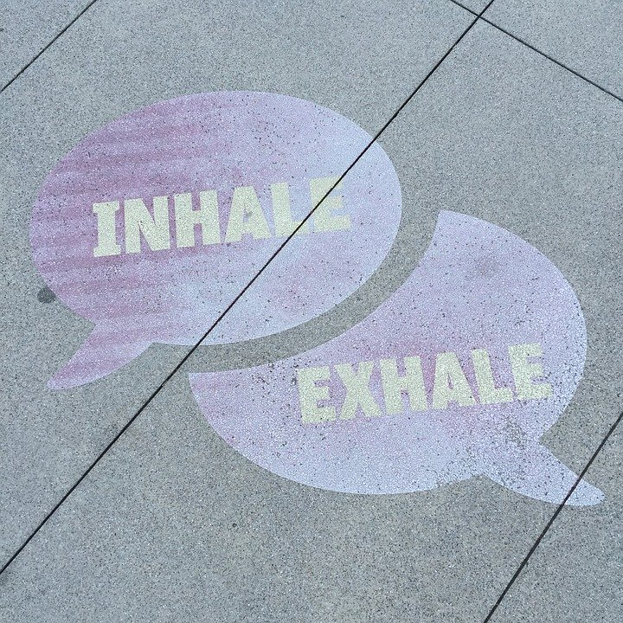
Selling your idea

Slide 3
What is self-care?
Break out time!!!
What comes to mind with the phrase “self-care”?
Emotional What are barriers to engaging in self-care activities?
Simple

Slide 4
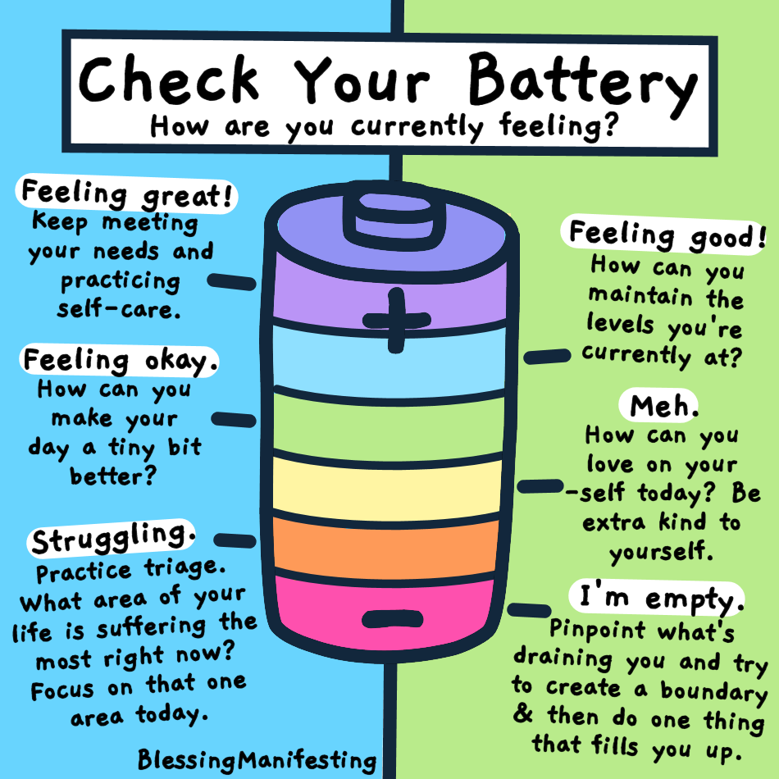
How can you tell when your battery is low?

Slide 5
We’re in a crazy time….
Uncertainty
Isolation/distance
Grief and loss
Change/Firsts
New roles
.
Unlocking Us Podcast by Brene’ Brown, PhD
(Warning….some cuss words)

Slide 6
Expect an Emotional Rainbow

Slide 7
A few suggestions…
Breathe
Stay connected to family, friends, co-workers
Accept that there may be a new normal and try to embrace it
Feel the feels
5. Give yourself GRACE

Slide 8
Resources
1. The Pandemic Toolkit Parents Need
8 expert tips to help families stay regulated
2. 6 Tips for Dealing with the Physical Toll of Working from Home
3. http://www.helpstartshere.org/

