Slide 1
What are Program Outcomes & what is their purpose?
Tim Burrows, Ph.D.
Director of Assessment and Accreditation
Presentation includes information from workshops originally presented by DePaul University, Loyola University, & Virginia Tech

Slide 2
Workshop Agenda
Overview of assessment and what it means for you and HLC
Definition and Purpose of Program Outcomes
What to write when you’re creating Program Outcomes
Questions

Slide 3
Workshop objectives
Define and identify program outcomes and related concepts
Identify relevant considerations when writing program outcomes
Write effective program outcomes

Slide 4
Assessment Overview
Part I

Slide 5
Assessment Overview
Assessment overview
What is assessment?
Why do we do assessment?
Are we required to do assessment?
Developing a Program Assessment Plan: What is included in the three part series?
Part I: Developing a mission statement and writing good program outcomes.
Part II: Implementing appropriate measures, creating additional assessment maps, developing targets, and analyzing data
Part III: Designing an action plan, closing the loop, and reporting results

Slide 6
What is assessment?
Suskie (2009, p.4) defined assessment as an ongoing four‐step process:
“establishing clear, measureable expected outcomes of your unit;
ensuring that you have sufficient opportunities to achieve those outcomes;
systematically gathering, analyzing, and interpreting evidence to determine how well your unit’s performance matches your expectations;
using the resulting information to understand and improve your performance.”
Suskie, L. (2009). Assessing student learning: A common sense guide
(2nd ed.). San Francisco: Jossey‐Bass.

Slide 7
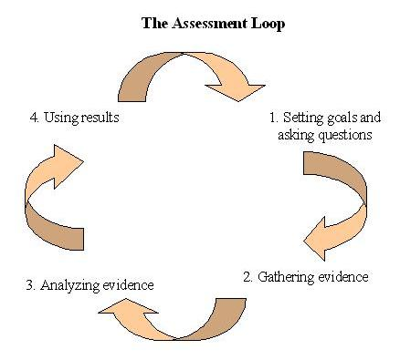
The Assessment Cycle

Slide 8
What does Assessment do for you?
Helps identify a program’s strengths and areas for improvement
Provides evidence for stakeholders including discipline‐specific and regional accreditors
Highlights the positive contributions of the program to stakeholders
Encourages collaboration among faculty in the program
Creates a program vision and ideal
Encourages the review of the unit as a whole
BUT THE PRIMARY BENEFIT OF ASSESSMENT is improved performance.

Slide 9
What are the HLC requirements for program assessment?
The Higher Learning Commission (HLC) Comprehensive Standard
Criterion 4. Teaching and Learning: Evaluation and Improvement. The institution demonstrates responsibility for the quality of its educational programs, learning environments, and support services, and it evaluates their effectiveness for student learning through processes designed to promote continuous improvement.
4.B. The institution demonstrates a commitment to educational achievement and improvement through ongoing assessment of student learning.
The institution has clearly stated goals for student learning and effective processes for assessment of student learning and achievement of learning goals.
The institution assesses achievement of the learning outcomes that it claims for its curricular and co-curricular programs.
The institution uses the information gained from assessment to improve student learning.
The institution’s processes and methodologies to assess student learning reflect good practice, including the substantial participation of faculty and other instructional staff members.
HLC (May 2019). https://www.hlcommission.org/Policies/criteria-and-core-components.html

Slide 10
What are some things HLC considers when examining this standard?
“How are expected outcomes clearly defined in measureable terms for each administrative unit?
What assessment instruments are used and why were they selected?
Have the programs assessed the extent to which they have been successful in achieving their outcomes?
If called for, have program improvements been made as a result of assessment findings?”

Slide 11
Definition and Purpose of program Outcomes
Part II

Slide 12
What is an outcome?
A statement in specific and measurable terms of what a program or department will be able to do as the result of having successfully following a developed plan (based on prior data).

Slide 13
Characteristics of Outcomes (Maki, 2010)
Describes what a student (or program) should be able to demonstrate, represent, or produce
Relies on active verbs
Aligns with collective program and institutional level educational (or strategic) intentions

Slide 14
Purpose of program outcomes
Program outcomes inform stakeholders of what services they will gain through an interaction with the unit.
They communicate expected standards of performance.
They provide a structure for evaluating the goals of the unit.

Slide 15
program Outcomes
Program Outcomes
Derived from mission and purpose
Achievement = Effectiveness
Require criteria to define levels of effectiveness
Individual and collective feedback to shape department programs and services
Assessment: how effective were we?
Is the train headed in the right direction?
Is the unit benefiting the overall mission of VMI?

Slide 16
What to write when you’re creating program Outcomes
Part III

Slide 17
Layers of program Outcomes
Institute Goals/Objectives
Operational Unit Level Outcomes
Program Level Outcomes

Slide 18
Levels of program Outcomes
Institute Goals/Objectives
allows for integration, shared responsibility for outcomes across units
Operational Unit Level Unit Outcomes
Outcomes can be achieved through multiple programs and services offered within a department, such as Finance, Administration, and Support
Program & Student Level Outcomes
Outcomes can be achieved within one program area

Slide 19
Institutional Level of Specificity
Program outcomes
Operational Unit outcomes
University outcomes

Slide 20
Outcome Alignment
Make sure your outcomes align with the appropriate institutional level of outcome
The broader the audience, the broader the outcome
As program outcomes become more specific, they are less likely to apply to higher level goals, but are easier to assess.

Slide 21
The big questions
What are the most important things for your program to achieve?
What are the necessary tasks that your program must complete in order for VMI to achieve its mission and goals?

Slide 22
Questions about
Program Outcomes?

Slide 23
Resources for writing program outcomes
Director of Assessment and Accreditation
Dr. Tim Burrows
Email: timothy.burrows@und.edu
Assessment website: https://www1.und.edu/research/institutional-research/assessment/

