Slide 1
Writing & Measuring Effective Learning Outcomes
Tim Burrows, Ph.D.
Director of Assessment and Accreditation
Presentation includes information from workshops originally presented by DePaul University, Loyola University, & Virginia Tech

Slide 2
Workshop Agenda
Definition and Purposes of direct and indirect measures
What to write when you’re creating Learning Outcomes
How to assess your learning outcomes
Questions

Slide 3
Workshop objectives
Distinguish between cognitive and affective types of learning outcomes
Identify relevant considerations when writing learning outcomes
Write effective learning outcomes
Determine the most effective assessment for your learning outcomes

Slide 4
Writing Effective Learning Outcomes
Part I

Slide 5
Best Practices in writing learning outcomes
Student-centered
Faculty/staff should collaboratively author and collectively accept
Clear and concise
Observable & Measurable
Use action verbs
Manageable number
Tied to core curricular and co-curricular mission/goals/values
Consider professional organizations’ expectations (as appropriate)
(Realistically) Aspirational/Developmental (at the right level for your students)
Meaningful
What are Characteristics of Good Student Learning Outcomes; Maki (2010)

Slide 6
If learning outcomes were math…
Basic formula:
Students + will (or will be able to) + action verb
(target audience) (future tense) (measurable behavior)
+ description = Learning Outcome!
(description of what students will know or be able to do)
Example:
Students + will (or will be able to) + action verb
(Economic Students) (will be able to) (model)
+ description = Learning Outcome!
(growth patterns and trends of a business using linear data.)

Slide 7
Adding to the equation
Outcomes can also include:
Degree of achievement
Quantification (e.g. number of concepts to identify)
Music students will be able to identify and analyze four elements of music in a given piece.
Standard (e.g. without making any errors, at a professional level)
Music students will be able to accurately identify and analyze four elements of music in a given piece.
Criteria
Using what tool or activity (e.g. using field tests, source documentation, through case studies)
Music students will be able to identify and analyze elements of music in a given live music piece.
Conditions
Specification of the course/activity/program (e.g. “As a result of participating in the workshop on diversity, students…”)
Students who complete the BA in Music program will be able to identify and analyze elements of music in a given piece.
http://assessment.uconn.edu/primer/goals1.html http://www.uta.edu/ier/Resources/ABCD_Outcome_Writing_Model.pdf http://ets.tlt.psu.edu/learningdesign/objectives/writingobjectives

Slide 8
Example learning Outcomes
Students will be able to apply knowledge of assessment, content delivery, and communication strategies in designing their own online courses.
By the end of the psychology program, students will be able to analyze Chicago housing data using multiple regression and predict social behaviors.

Slide 9
Tools that help distinguish levels of learning
Learning Outcomes in higher education should ideally focus on higher-order skills
Bloom’s Taxonomy: Cognitive
The cognitive domain involves knowledge and the development of intellectual skills (Bloom, 1956). This includes the recall or recognition of specific facts, procedural patterns, and concepts that serve in the development of intellectual abilities and skills.
Bloom & Krathwohl’s Taxonomy: Affective
The affective domain (Krathwohl, Bloom, Masia, 1973) includes the manner in which we deal with things emotionally, such as feelings, values, appreciation, enthusiasms, motivations, and attitudes.

Slide 10
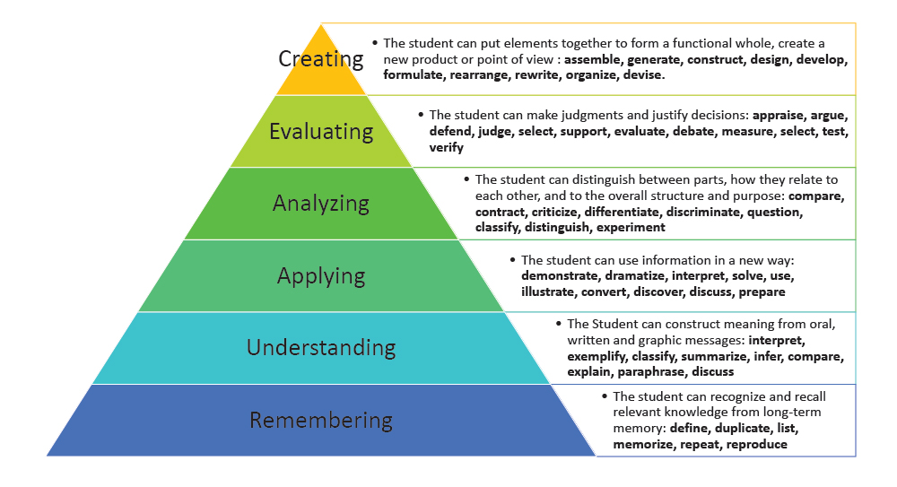
Bloom’s Taxonomy: Cognitive Domain
Adapted from: Bloom B. S. (1956). Taxonomy of Educational Objectives, Handbook I: The Cognitive Domain. New York: David McKay Co Inc.

Slide 11
Cognitive Domain Verbs & Strategies
Adapted from: Bloom B. S. (1956). Taxonomy of Educational Objectives, Handbook I: The Cognitive Domain. New York: David McKay Co Inc.

Slide 12
Bloom’s & Krathwohl’s Taxonomy: Affective Domain
Adapted from: Krathwohl, D., Bloom, B., & Masia, B. (1956). Taxonomy of educational objectives. Handbook II: Affective domain. New York David McKay.

Slide 13
Affective Domain Verbs

Slide 14
Common slip-ups
Using “understand,” “have knowledge of,” “be aware of,” “appreciate”…
Focusing on yourself rather than the student
Not enough/too many outcomes
Outcomes that are too complex (difficult for stakeholders to understand)

Slide 15
Measuring Effective Learning Outcomes
Part II

Slide 16
What should you consider when choosing an assessment measure?
Assessment measure is compatible with the outcome
The measure selected should provide reasonably accurate, useful information
The measure would yield results specific enough to know where improvements can be made
Assessment measure matches the cognitive level of the outcome (for student learning outcomes)

Slide 17
What should you consider when choosing an assessment measure?
Consider what is already being done:
Survey faculty on what activities are being done in their courses
Find out what is being done locally or Institute‐wide that might map to your outcomes
Utilize one activity for several outcomes where possible
Use capstone points in the curriculum

Slide 18
When selecting your measure what should your program ask?
Is the measure a reasonable indicator for the cognitive level specified in the student learning outcome?
Would this assessment method assist the program in other ways (meeting accreditation standards, provide feedback to students, etc.)?
Will the results of the assessment produce data that are trustworthy and understandable?
Is the development/preparation time involved in using this measure reasonable?

Slide 19
Direct Measures
Direct measures are tangible, visible, and observable
Allow someone to directly observe the student learning, usually via student work embedded in a course
Show a demonstration of a students’ knowledge or skill
Indicate a service or activity implemented by the program
For each student learning outcome the program should have at least one direct indicator of student learning.

Slide 20
Examples of Direct Measures
Student learning outcomes:
Student artifacts (ex. capstone projects, portfolios, presentations, case studies, etc.) examined by learning outcome and scored with a rubric
Externally reviewed exhibitions, performances, or projects scored by learning outcome
External evaluation of performance during internships based on outcomes.
Commercially‐developed tests, locally‐developed tests, national licensure exams or professional exams if examined by learning outcome
Program outcomes:
Number of students meeting certain criteria (ex. % attending graduate school) or number of projects or initiatives implemented (ex. courses developed, grants obtained, etc.)
Enrollment numbers / number of majors

Slide 21
Indirect Measures
An indirect measure is subjective and not directly observable
Asks students to reflect on their learning or abilities but does not provide direct evidence of the learning
Infers student knowledge
For each student learning outcome the program can have a combination of both direct and indirect indicators of student learning

Slide 22
Examples of Indirect Measures
Survey research: National or local instruments
National Survey of Student Engagement (NSSE),
Faculty surveys
Course evaluations
Employer satisfaction studies and advisory boards
Exit interviews and student focus groups
Self‐assessments
Peer ratings

Slide 23
Resources for writing learning outcomes
Director of Assessment and Accreditation
Dr. Tim Burrows
Email: timothy.burrows@und.edu
Assessment website: https://www1.und.edu/research/institutional-research/assessment/

