Slide 1
Learn the Signs. Act Early

Slide 2

Introduction

Slide 3
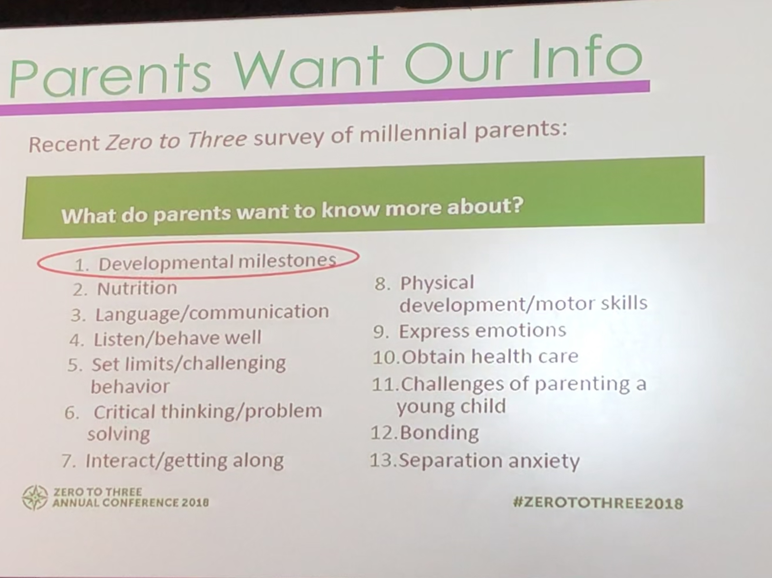
Parents want to know

Slide 5
Developmental monitoring is best done with an objective checklist of typical developmental milestones.
Using milestone checklists in developmental monitoring will help you:
  become a better observer of the development of children in your care;
  better understand the developmental milestones children should reach at certain ages;
  more easily pinpoint potential developmental concerns for a child;
  have an objective basis to talk with parents when you are concerned about a child’s development;
  and be better prepared to conduct developmental screening with a more formal tool if that is asked of you.

Slide 6
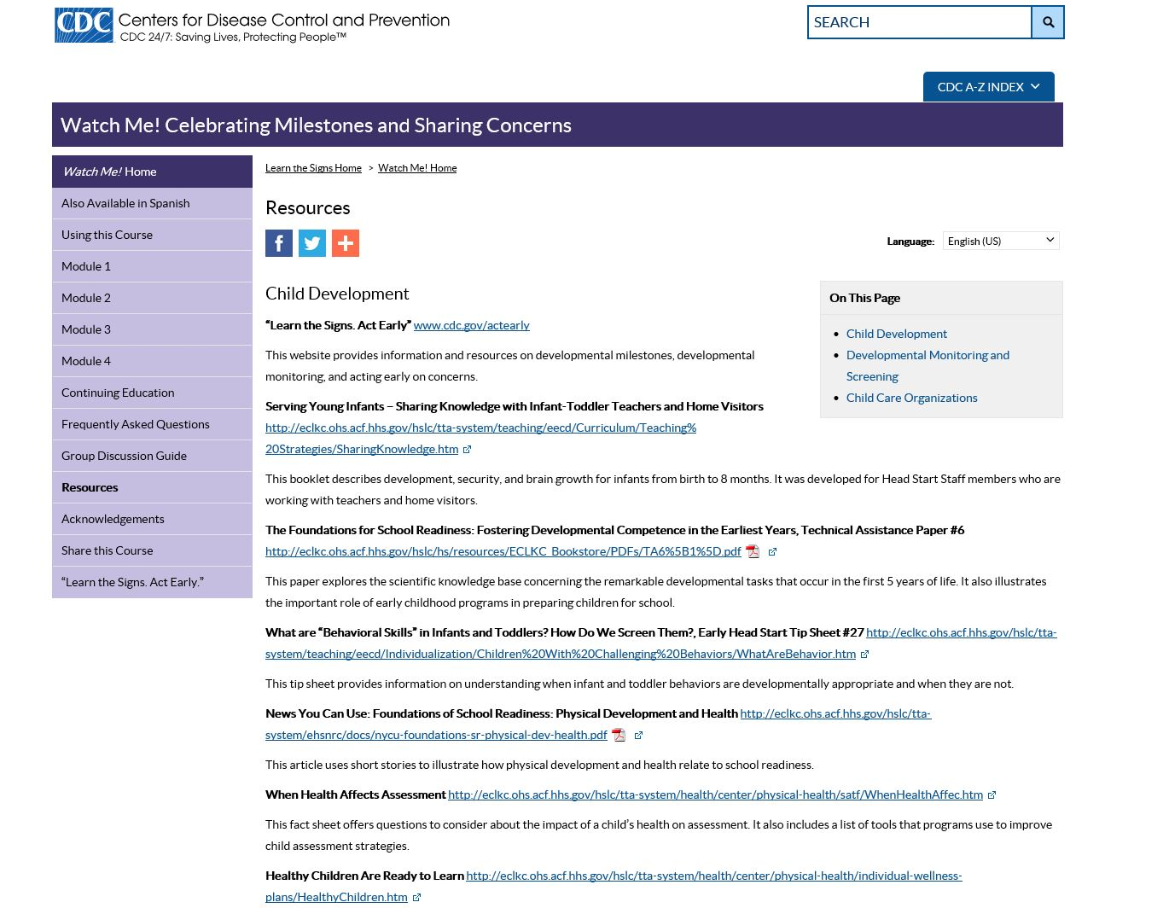

Slide 7
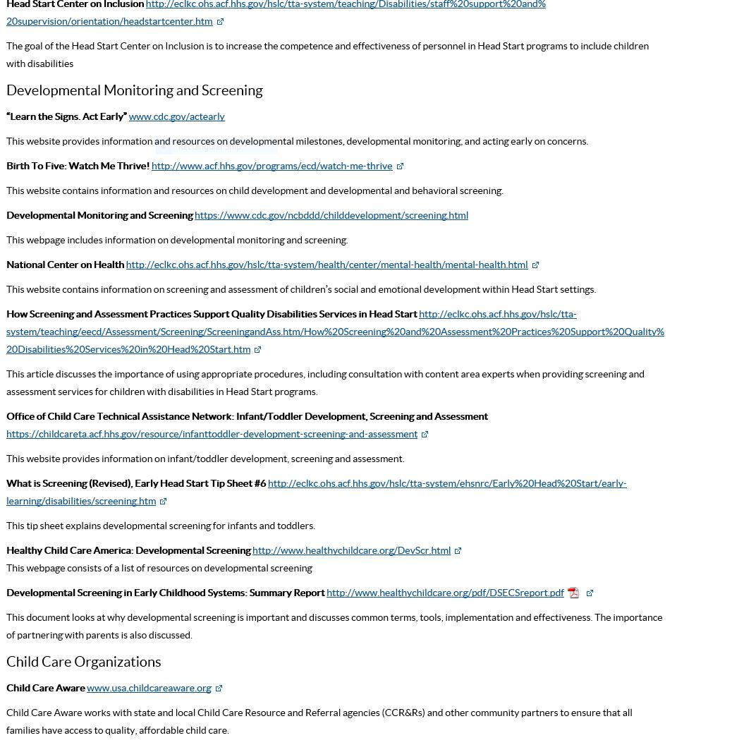

Slide 8
Materials
How to use CDC tools for developmental monitoring
Developmental monitoring can be easy and fun when you have the right tools. The Centers for Disease Control and Prevention, or CDC, through its “Learn the Signs. Act Early.” program, offers free, easy-to-use milestone checklists, and other materials to help.

Slide 9
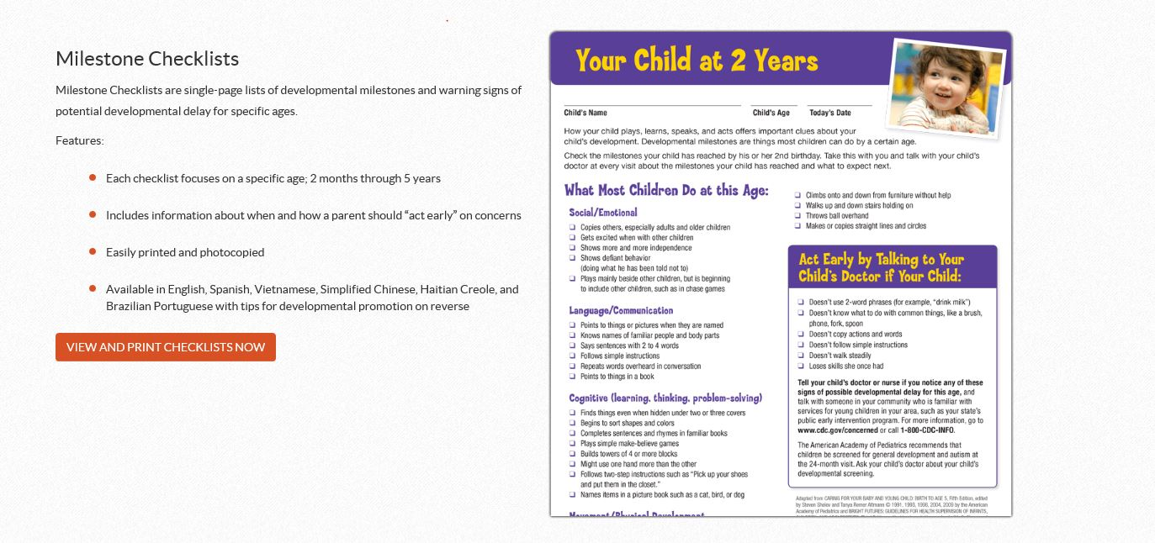

Slide 10
Tips for Using the Milestone Checklists
Print a copy of a checklist for every child at the start of the school year; every month, take time to update each child’s checklist with the milestones he or she has reached
Print a copy of a blank checklist for each child’s family; let them know you’ll be updating it each month and encourage them to do the same at home
Review the latest checklists at every parent/teacher conference as a way to share the child’s progress with the parents
If a child is between two ages for which checklists are offered, use the checklist for the younger age (for example, use the 18-month checklist for a 20-month old child, NOT the 24-month checklist).

Slide 11
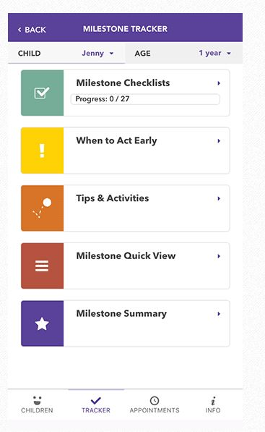
Milestone App

Slide 12
CDC's FREE Milestone Tracker app helps parents and early care and education providers track child’s milestones from age 2 months to 5 years, using a smart phone or tablet. You can use the app to track the milestones of multiple children, view a photo or video of each milestone, quickly reference milestones by age and category, and find out what to do if you are ever concerned about a child's development.
Features:
  Personalize checklists for multiple children
  View photo and video examples of each milestone
  Get tips and activities to support a child’s development
  Get a notice when it’s time to “act early” and talk with parents about developmental concerns
  Generate milestone summaries to share with a parent or other important care providers

Slide 13
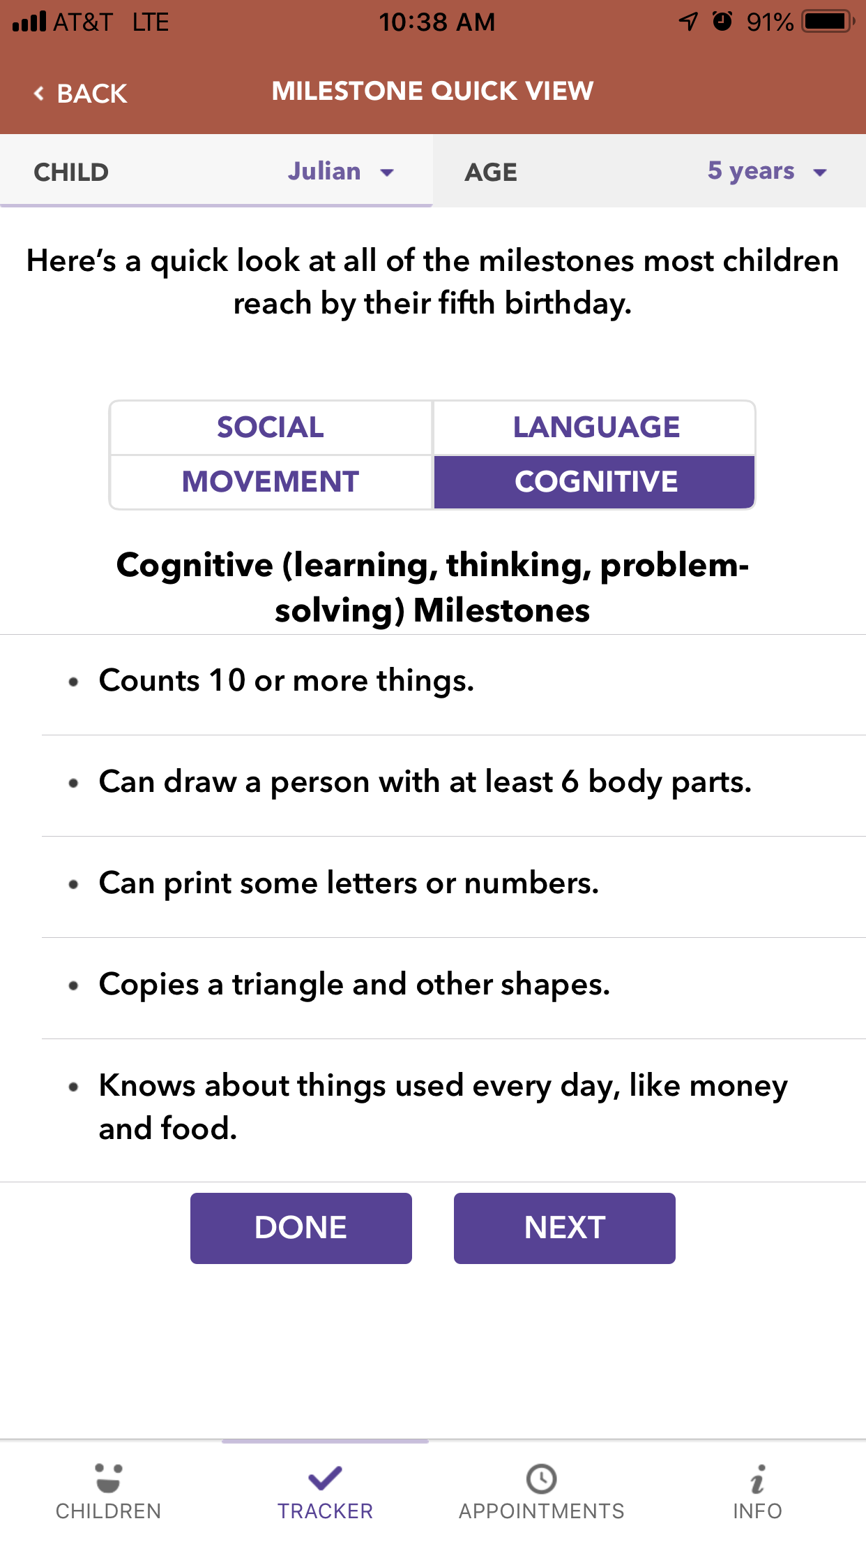

Slide 14
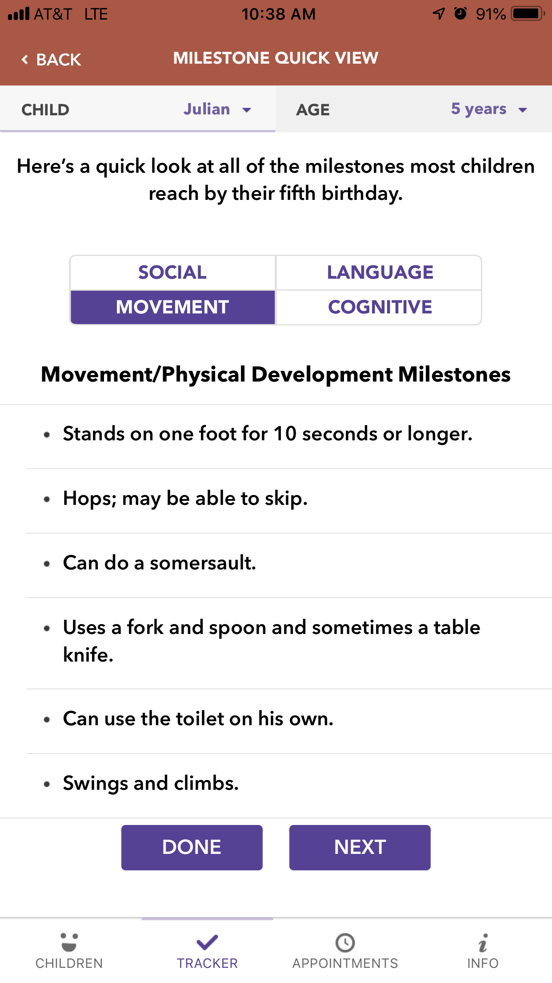

Slide 15
Tips for Using CDC's Milestone Tracker app
Post a Milestone Tracker flyer in your classroom or your center’s front lobby
Encourage parents to download the app and use it to monitor their child's development
Use CDC's Milestone Tracker app and the milestone summary it generates to support observations and conversations with parents about age-appropriate milestones

Slide 16
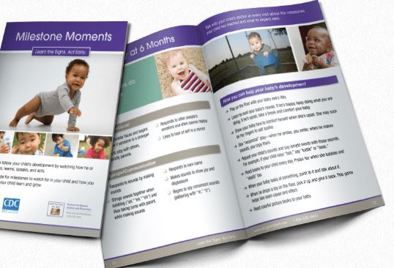

Slide 17
Booklet
Milestone Moments Booklet
The Milestone Moments Booklet is a 42-page mini-booklet that includes full milestone checklists from 2 months through 5 years of age, with milestones and warning signs for each age. It also includes age-appropriate activities that you can try in the classroom and parents can try at home to help their children learn and grow. This booklet is intended to be kept and used over time.
Features:
  High-quality resource to be kept and used over time to record a child’s development
  Suggests age-appropriate activities to help children learn and grow
  Includes information about when and how a parent should “act early” on concerns
  Available in English, Spanish, Simplified Chinese, and Korean
  Pre-printed copies available free in LIMITED quantities

Slide 18
Tips for Using the Milestone Moments Booklet
Provide a copy to every family when their child enrolls; encourage families to use it at home (See end of this section to learn how to customize and print copies for every family)
Try at least one of the suggested activities from the booklet as part of your in-classroom activities
Include at least one of the suggested activities from the booklet in each edition of your monthly newsletter for parents to try at home

Slide 19
Brochure
Milestones Brochure: Track Your Child’s Developmental Milestones
The Milestones Brochure is a colorful and engaging trifold brochure that introduces a few key milestones for ages 6 months to 4 years and explains the importance of looking for milestones and acting early on concerns about development.
Features:
  A great introduction to the importance of developmental monitoring and acting early on concerns
  Highlights a few key milestones for a variety of ages
  Available in English, Spanish, Vietnamese, and Korean
  Easily printed and photocopied

Slide 20
Tips for Using the Milestones Brochure
Laminate a copy and post it to the bulletin board outside your classroom
Include copies of the brochure in the parent resource center and in the lobby
Post a link to the brochure on your center’s website
Post on the staff refrigerator as a friendly reminder to your coworkers of the importance of developmental monitoring

Slide 21
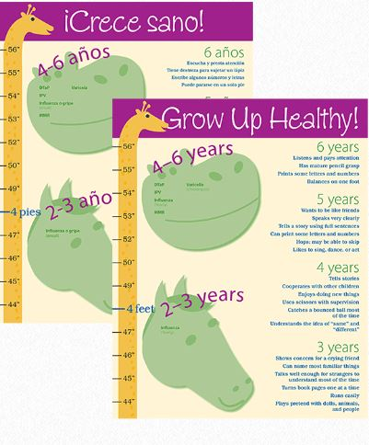

Slide 22
Growth Chart
Grow Up Healthy! Growth Chart
The Grow Up Healthy! Growth Chart is a engaging display for the classroom and a reminder to watch and record both physical AND developmental growth. It includes recommended immunizations by age and a sampling of milestones that children should reach by different ages.
Features:
  A useful reminder of the importance of tracking both physical and developmental growth
  A nice, colorful addition to your classroom walls
  Highlights recommended immunizations and a few key milestones at different ages
  Available in English and Spanish
  Pre-printed copies available free in LIMITED quantities

Slide 23
Tips for Using the Grow Up Healthy! Growth Chart
A few times each year, mark each child’s height on the growth chart. At the same time, make a mental note about how each child is meeting or working toward the milestones listed.
Give each child their own growth chart on his or her birthday for the family to use at home. (See the end of this section to learn how to customize and print copies for every family.)

Slide 24
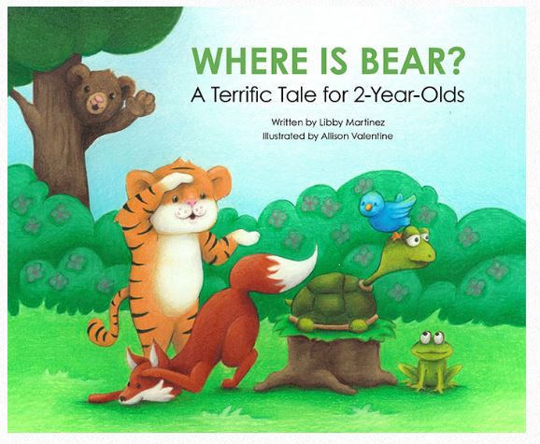

Slide 25
Where Is Bear? A Terrific Tale for 2-Year-Olds
This children's book is a terrific tale for 2-year-old children! This engaging and interactive book encourages children to help Tiger and his forest friends in their search to find Bear. With each turn of the page, children will get closer to finding Bear and teachers and parents will learn about many important milestones to look for in 2-year-old children.
Features:
  Beautiful illustrations that will captivate young children
  “Milestone Moments” called out at the bottom of the pages for teachers and parents
  Full 2-year-old developmental milestone checklist and age-appropriate activities in the back
  Full 3-year-old developmental milestone checklist and age-appropriate activities in the back
  Also available in Spanish
  Pre-printed copies available free in LIMITED quantities.

Slide 26
Tips for Using Where is Bear?
  Order a copy for the 2-year-old classroom and incorporate it into reading time
  Give a copy to families with 2-year-olds to help encourage them to read to their child everyday

Slide 27

Amazing me- It’s busy being 3!

Slide 28
Amazing Me — It’s Busy Being 3!
This children’s book, for kids 2½ through 4 years of age, is really AMAZING! It tells the story of Joey and all the things he can do now that he is 3. Throughout the story, Joey’s amazing developmental milestones are called out for teachers and parents at the bottom of almost every page. It’s another great reminder of all the AMAZING developmental milestones to be looking for each day!
Features:
  A fun story, tested with teachers, parents, and children, that keeps the attention of a young audience
  Beautiful illustrations depicting activities relatable to many children
  “Milestone Moments” called out at the bottom of the pages for teachers and parents; and a koala for the children to find each time Joey shows an amazing milestone!
  Full 3-year-old developmental milestone checklist and age-appropriate activities in the back
  Interactive e-version available at www.cdc.gov/AmazingMe
  Pre-printed copies available free in LIMITED quantities

Slide 29
Tips for Using Amazing Me
Order a copy for the 3-year-old classroom and incorporate it into weekly reading circle time.
Read it aloud to parents and children in the 3-year-old room during an annual “open house” or other event for parents.
Give a copy to each child on his or her 3rd birthday so families can read it at home. (See end of this section to learn how to customize and print copies for every family.)

Slide 30
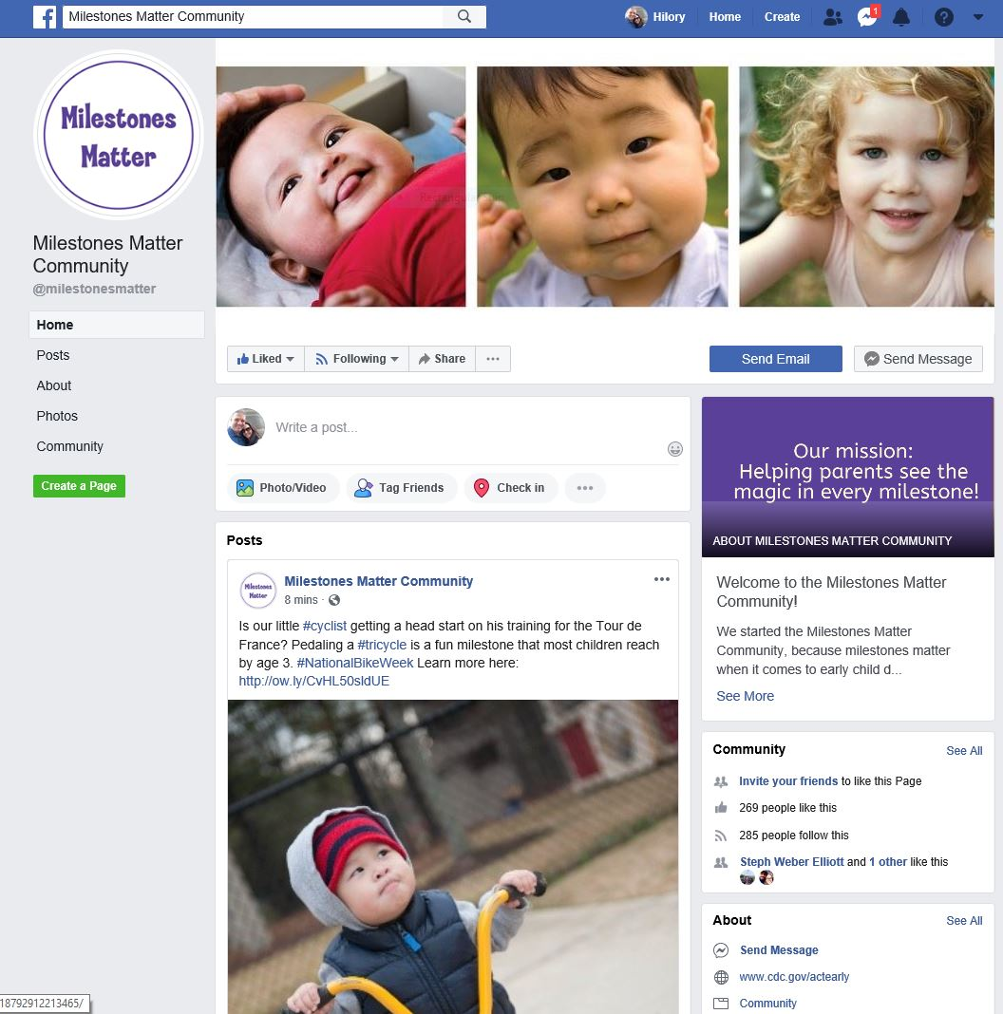

Slide 31
All of CDC’s “Learn the Signs. Act Early.” materials are:
Research-based
Easy to understand
Parent-tested
Reproducible (no copyright)
Available in English and Spanish
Available to download or print
Popular!
Free in LIMITED quantities
CUSTOMIZABLE and can be printed locally in the quantities you need

Slide 32
Discuss healthy development regularly
Celebrating milestones is infectious! Families begin to see the importance of those accomplishments and will want to take notice as well. Children grow up so quickly; it is as if one day they are beginning to sit up and the next they are playing baseball. All the “small” steps in between represent important developmental milestones: rolling over, sitting up, crawling, cruising, walking, running, and others.
Just like these movement milestones that are so familiar to parents, their child’s social/emotional, communication/language, and cognitive developmental milestones also progress in a series of orderly steps. In addition, there can be clues in those steps that could alert parents to a potential developmental concern.

Slide 33
Sharing milestones with parents can help them have realistic expectations and better understand their child’s behaviors. If parents do not know when a child should have a certain skill, they may worry unnecessarily.
For example:
If a parent says she is concerned that her 2-month-old is not rolling over, you can reassure her that rolling over from tummy to back is a typical milestone at 4 months.

Slide 34
Encourage families to use developmental milestone checklists to monitor their child’s development.
Milestone checklists and the Milestone Moments booklet from CDC’s “Learn the Signs. Act Early.” program are easy-to-use, proven tools as useful for families as they are for you.
These materials can help families understand what typical developmental milestones are at certain ages and can help establish appropriate expectations. Not only will these materials give parents a snapshot of what their child is doing right now, they will help them to anticipate developmental milestones that are emerging or will come next. Having milestone checklists as a reference can greatly help you and the parent think about what kinds of toys might be appropriate and how to create an environment that encourages the child's development.

Slide 35
How to communicate when you have a concern
Communicating concerns with families about their child’s development will be much easier if you have already established a meaningful relationship, are prepared, and focus your conversation on specific developmental milestones.

Slide 36
Use the completed milestone checklist as the basis for your conversation. The checklist is an objective tool that can both confirm and pinpoint your concerns.
And because it was developed by CDC and is based on the gold-standard milestone lists from the American Academy of Pediatrics, it offers you enhanced credibility and objectivity in your conversation.

Slide 37

Learn the Signs-Act Early Materials
Various materials are available with the CDC and Learn the Signs-Act Early
An app is available for free to track developmental milestones
Checklists for every age are available to track milestones
Many other materials are available for tracking children’s progress at https://www.cdc.gov/ncbddd/actearly/resources.html

Slide 38
Next steps if you have concerns:
Talk to your primary care physician
Seek private services (OT/PT/SLP)
Birth- three- Early Intervention
Over 3- Special Education Services through your local school district
Family Support services

Slide 39

Infant Development Programs
The North Dakota Department of Human Services offers various infant development programs
Experienced Parent Program-provides support to families of children with developmental disabilities
North Dakota Developmental Wheel Early Intervention Services-provides information about various disabilities
Right Track-provides support and information to families of children with disabilities
More information is available at https://www.nd.gov/dhs/services/disabilities/earlyintervention/parent-info/index.html

Slide 40

Family Voices of North Dakota
Provides assistance and supports for families of children with disabilities
Assistance is given through a family-centered care approach
Areas that are supported are making informed decisions, advocating, building partnerships, and health care resources
More information is available at http://fvnd.org/site/index.php/about-us/our-mission/

Slide 41

Pathfinder Services of North Dakota
A non-profit organization that assists families of children with disabilities
Provides trainings, individual assistance, and resources
Mission: “To unite families and educators by giving them the resources to build positive futures for and with children, students and young adults with learning differences or challenges.”
More information is available at http://www.pathfinder-nd.org/index.php?option=com_k2&view=item&layout=item&id=70&Itemid=27

Slide 42

North Dakota Center for Persons with Disabilities
NDCPD assists and supports people with disabilities and their families
Trainings, technical assistance, service, research, and information is provided
Overall supports the well-being of people with disabilities with their individual needs
More information is available at http://www.ndcpd.org/

Slide 43

North Dakota Special Health Services
Servicing children with special health care needs and their families
Multidisciplinary clinic
More information: https://www.ndhealth.gov/cshs/

Slide 44

Federation of Families for Children’s Mental Health
ND Federation of Families for Children's Mental Health is a parent-run organization focused on the needs of children and youth with emotional, behavioral or mental disorders and their families.
Families Helping Families by providing:
Support
Advocacy
Education
http://ndffcmh.org/

Slide 45
Questions??
Hilory Liccini
  Assistant Director, North Dakota Center for Persons with Disabilities
  North Dakota Act Early Ambassador
  858-3008
  Hilory.Liccini@minotstateu.edu

