Slide 1
RQ-4B Global Hawk Lessons learned from stratospheric operations
Major Ryan ‘Machete’ Blakeney
319 RW A3 Director of Operations
Overall Classification: UNCLASSIFIED

Slide 2
Overview
Aircraft
Cockpit
Scheduling
Weather
Environmental Information
Temperature Considerations
Flight Characteristics
Emergency Procedures

Slide 3
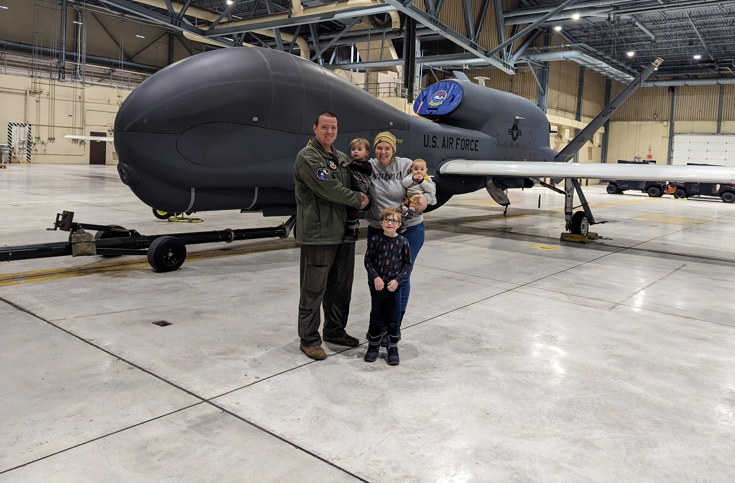
RQ-4B Global Hawk
Unmanned High Altitude Long Endurance Aircraft
The wingspan is 130 feet 10 inches
The height at the tail is 15 feet 5 inches
The fuselage length is 47 feet 7 inches
Up to 60,000 ft
Longest duration 34.3 hrs

Slide 4
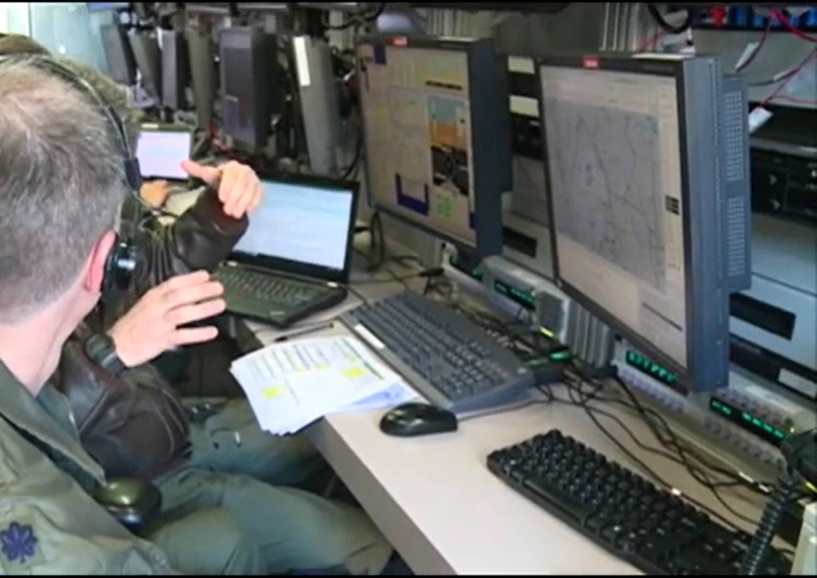
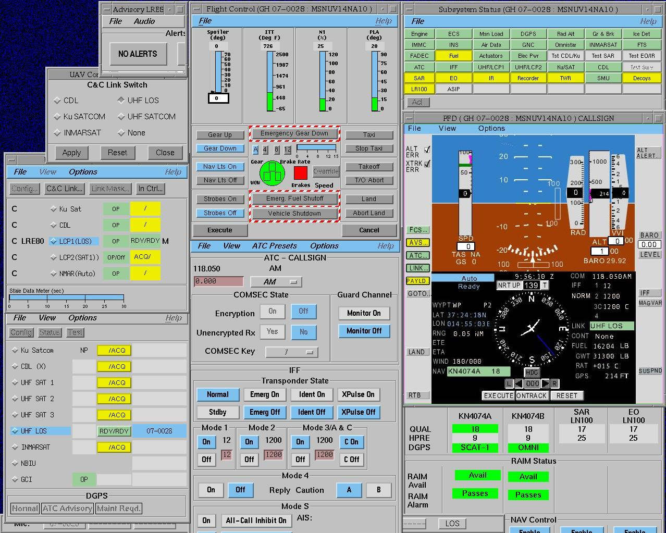
Cockpit

Slide 5
Scheduling
Crew Scheduling
Considering multiple 24 hour+ flights
4-12 hour shifts with 8 hours being the sweet spot
Require aircrew to be qualified in different aspects of the mission (takeoff, landing, mid-mission)
If you have multiple crew stations, scheduling becomes more complex (pilot & sensor operator)
Performing the same mission every time they fly can create complacency
What is someone is sick, on leave, unable to fly?
Crew Rest
12 hours in between flight duty days
Debrief/Lessons Learned
How can we do that better next time? (commonly overlooked)

Slide 6
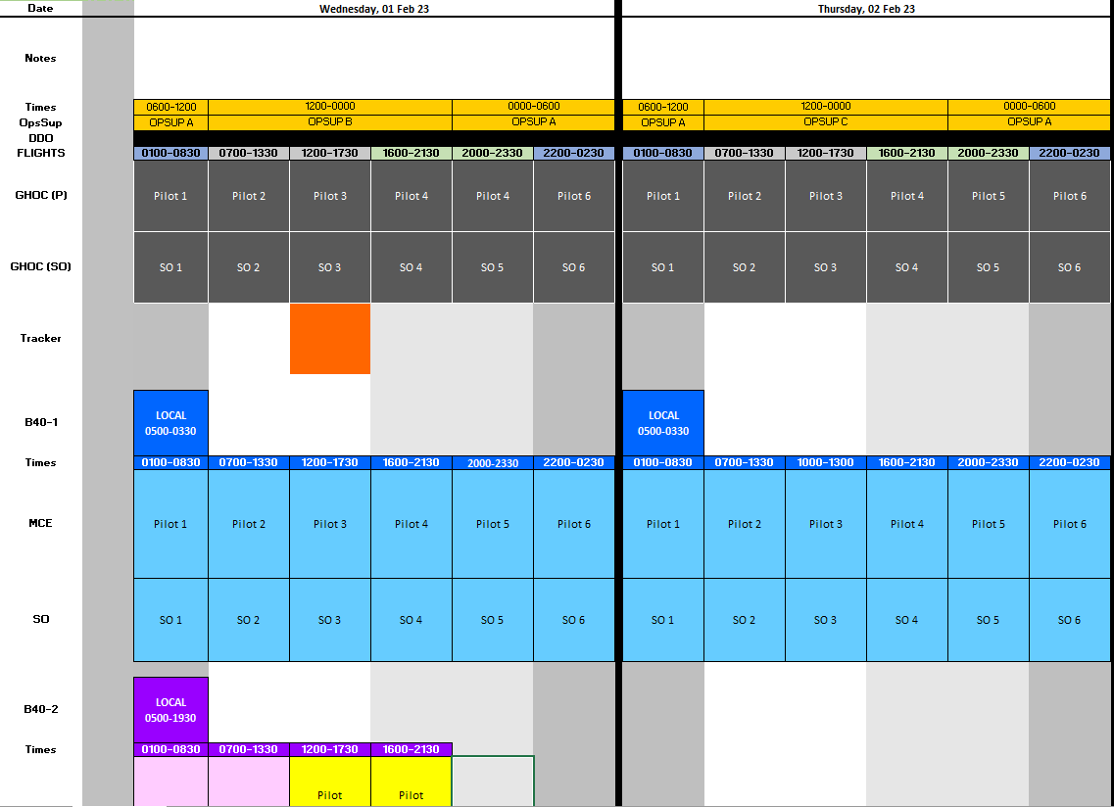
Crew Scheduling

Slide 7
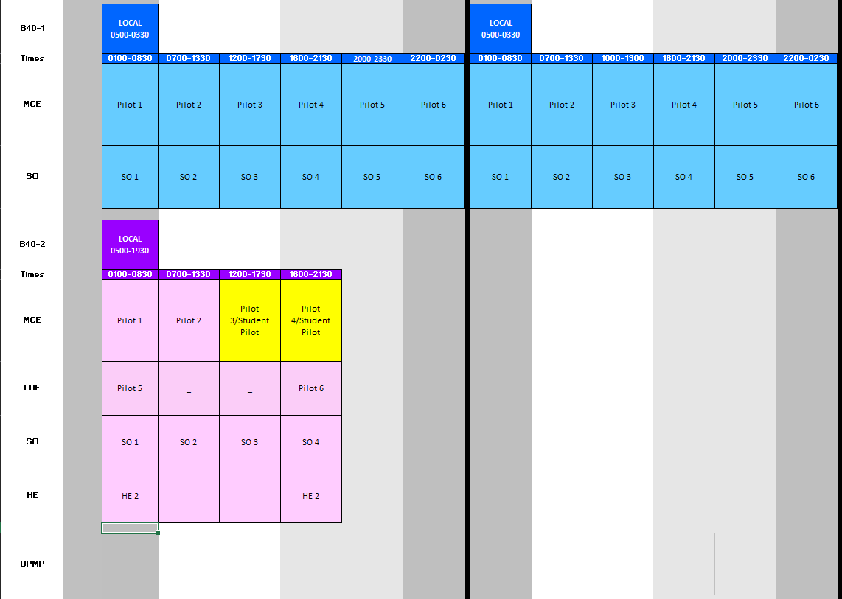
Crew Scheduling
24 Hour Scheduling
Crew Rest
Debrief

Slide 8
Weather

Slide 9
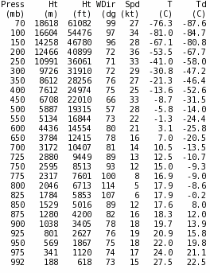
Takeoff Weather VT: 18 JAN 2023
CLOUDS: FEW015
VIS/WX: 9999 / NSW
WINDS: 09015KT
TEMP/DEWPT: 27°C / 22°C
ALSTG/PA: 29.94 / +600FT
HAZARDS: NONE
WWA: NONE
FZ LEVEL: 170
CLIMB WINDS: PLEASE SEE CHART
RED indicates X wind > 15KT, CIG/VIS < 3200’

Slide 10
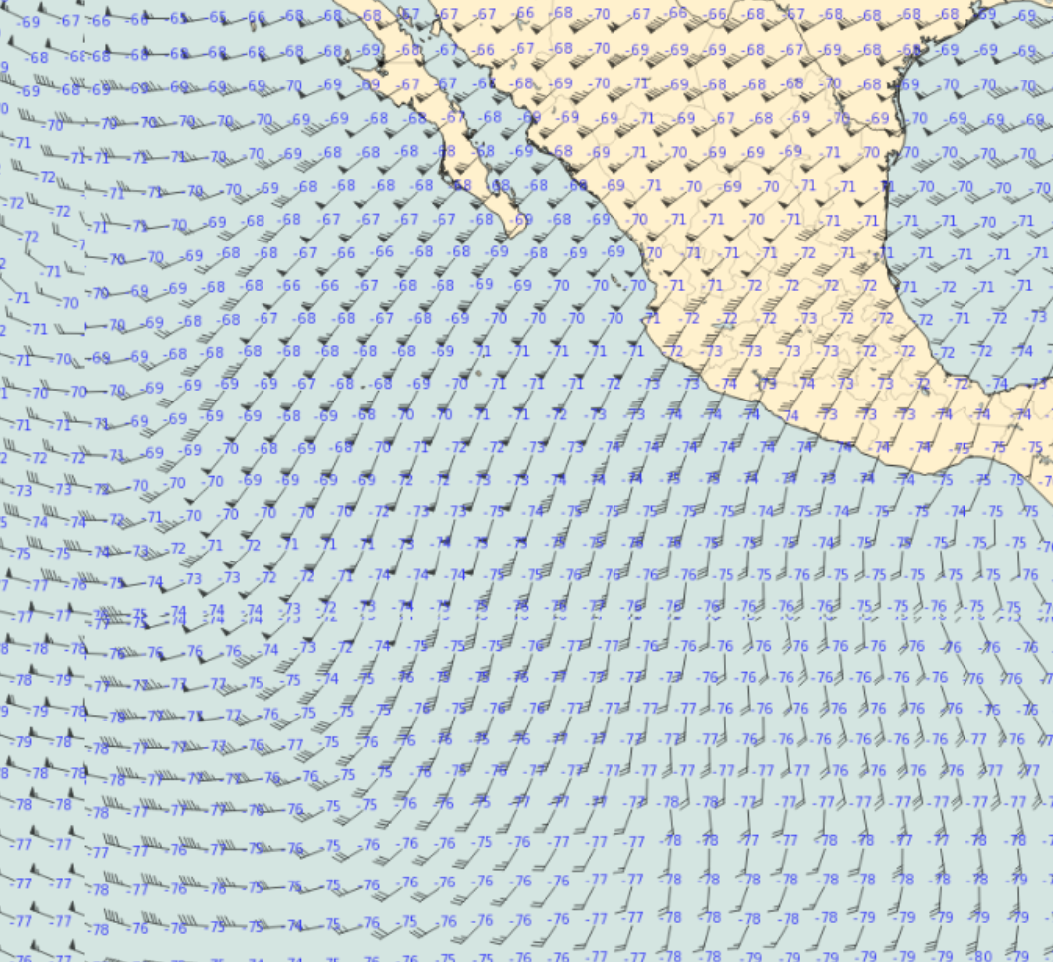
FL540 Winds & Temps

Slide 11
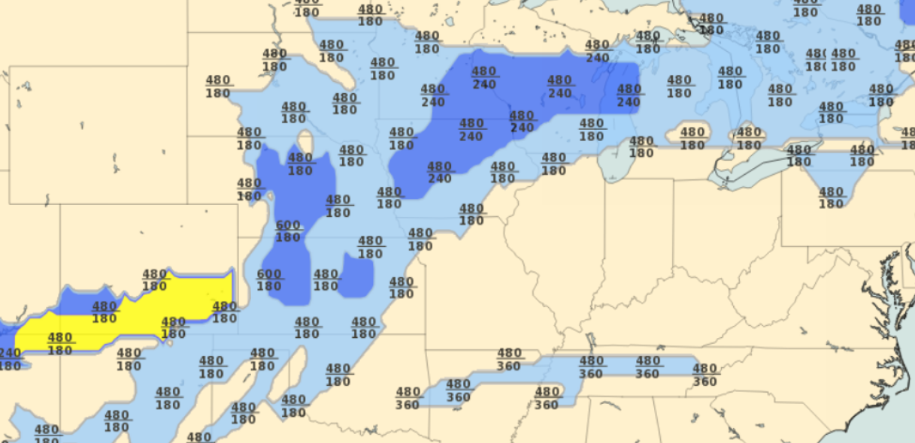
Upper-level Turbulence

Slide 12
Volcanic Events
Volcanic Ash Advisory Center Bulletins
Location: 29.5131, 129.4196
FVFE01 RJTD 250715
VA ADVISORY
DTG: 20220925/0715Z
VAAC: TOKYO
VOLCANO: SUWANOSEJIMA 282030
PSN: N2938 E12943
AREA: JAPAN
SUMMIT ELEV: 796M
ADVISORY NR: 2022/765
INFO SOURCE: HIMAWARI-8 JMA
AVIATION COLOUR CODE: NIL
ERUPTION DETAILS: ERUPTED AT 20220925/0703Z FL070 EXTD W
OBS VA DTG: 25/0700Z
OBS VA CLD: VA NOT IDENTIFIABLE FM SATELLITE DATA WIND FL070 090/1KT
FCST VA CLD +6 HR: NOT AVBL
FCST VA CLD +12 HR: NOT AVBL
FCST VA CLD +18 HR: NOT AVBL
RMK: WE WILL ISSUE FURTHER ADVISORY IF VA IS DETECTED IN SATELLITE
IMAGERY.
NXT ADVISORY: NO FURTHER ADVISORIES

Slide 13
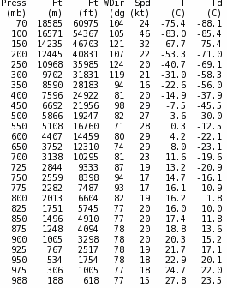
Landing Weather VT: 19 JAN 2023
CLOUDS: SCT015
VIS/WX: 9999 / VCSH
WINDS: 08015G20KT
TEMP/DEWPT: 25°C / 19°C
ALSTG/PA: 29.84 / +721FT
HAZARDS: POTENTIAL 15KT XWND
WWA: CHECK WITH LOCAL FLIGHT AGENCY
FZ LEVEL: 170
RED indicates X wind > 15KT, CIG/VIS < 3200’

Slide 14
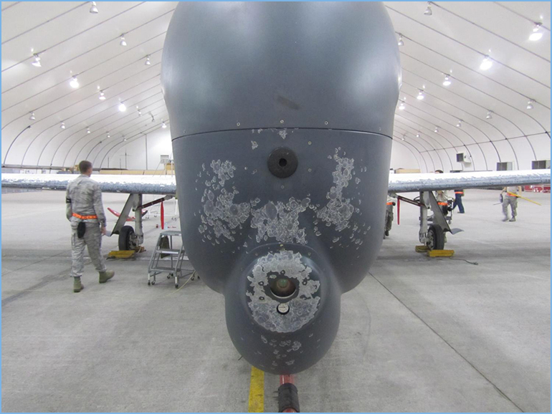
Thunderstorm Avoidance
Required to avoid thunderstorms by 20 Nautical Miles or fly over by 10,000 ft if above FL500.
Lightning
May cause physical damage to aircraft and computer systems
Hail
Can be encountered up to 45,000 feet and 20 miles away from the storm's center
Hailstones larger than 1/2 to 3/4 of an inch can cause significant aircraft damage in a few seconds

Slide 15
Icing
Aircraft has no anti-ice/de-icing capability
Induction icing is the #1 danger
If ice is encountered on takeoff, a climb check is accomplished to determine effects on flight characteristics
If climb performance is affected, aircrew must sublimate the ice to continue climbing
Sublimation can vary in time depending on the amount of ice and the amount of sunlight

Slide 16
Weather Lessons Learned
Having 24/7 weather personnel support during operations is CRITICAL
Onboard weather radar vs Satellite weather is situational on most cases
Global Hawk crews prefer satellite weather and weather personnel
If we bob and weave in between the weather, what happens if we lose link?
PIREPS are extremely useful for unmanned systems (we can’t look out the window)
Having alternates ready and making a decision early is a requirement

Slide 17
Environmental Information

Slide 18
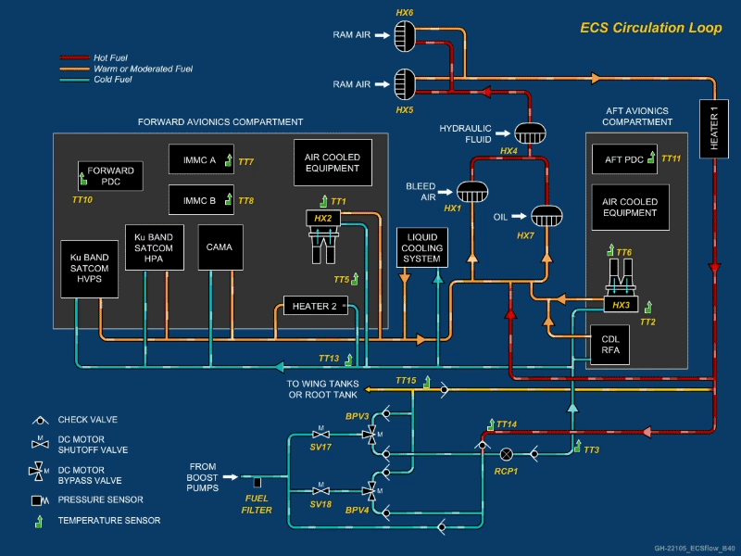
Environmental Control System
The ECS circulation loop is at the heart of the system and is designed to route temperature-controlled fuel to avionics compartments to maintain air temperatures and fuel system temperatures
Under certain quantity and temperature conditions, fuel is used for equipment cooling and returned to the fuel tanks where heat is dissipated through contact with the outer surfaces. This fuel is commonly referred to as “ECS return fuel”
If we are delayed on the ground in a hot environment, we can push fuel to the wing tips to cool it before it reenters the system

Slide 19
Temperature Considerations
Tires/Struts
No colder than −70°C (−94 °F) in the first 3 hours, after first 3 hours no colder than −68 °C (-90°F)
Sensor/Payload
When the sensor is in use, it must be cooled. When its off, it cools rapidly at altitude (danger of cold soaking)
Temperature increase due to friction
Normally expect 12 degrees increase in temperature on the aircraft compared to ambient temps
Inversion Layer
Depending on the location of the inversion layer, aircrew will climb or descend to maintain certain temperatures
Mission Planning for temperature
Locations and temperature at altitude are considered for fuel, location, and altitude for flights
Nonstandard systems used to manage heating or cooling
Turning on a system to use the warmth from its power supply

Slide 20
Flight Characteristics

Slide 21
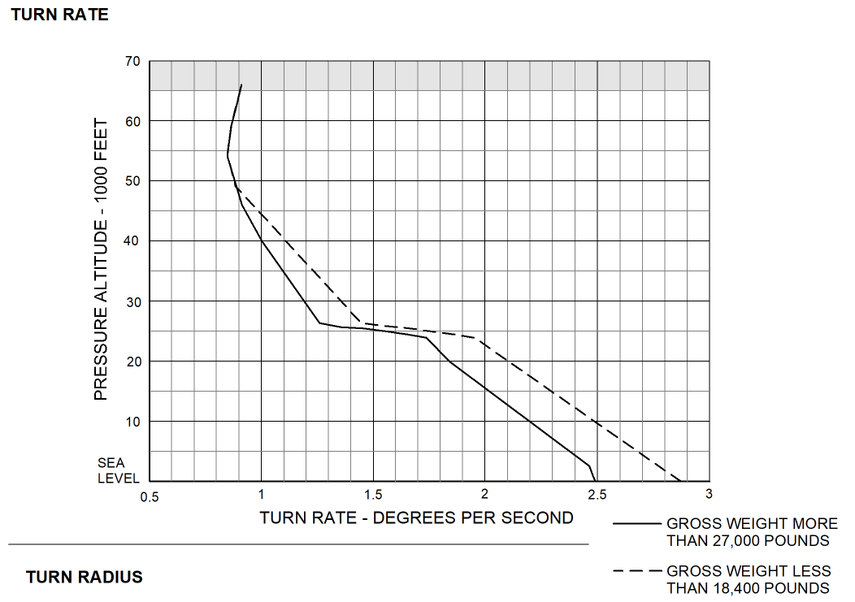
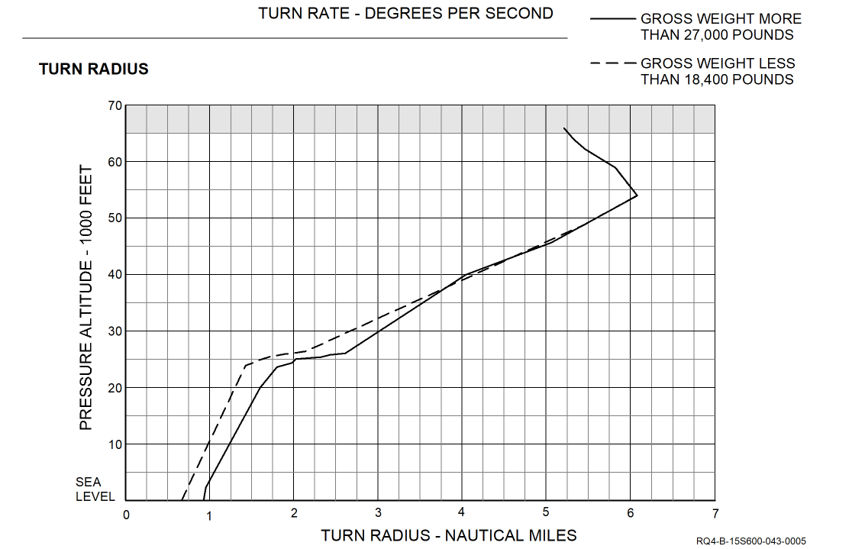
Turn Rate/Radius
Aircraft is limited to 15-20° of bank during normal flight operations
This limitation creates a longer turn radius, the higher we fly.
Turn radius, lost link scenarios, and workstation lock up requires us to create a stand off from any borders or restricted areas
Limited bank angle creates a limitation for some situations

Slide 22
Altitude, Airspeed, & Fuel Burn
In altitude hold at or below 45,000 feet, the ruddervators and spoilers are used to control the altitude and the throttle is adjusted to control airspeed and altitude control has priority over airspeed control.
In altitude hold above 45,000 feet, the ruddervators are used to control airspeed and the throttle is adjusted to manage both altitude and airspeed (energy).
Altitude variations up to 500 feet from the commanded altitude are possible.
Fuel Burn
Higher altitude doesn’t necessarily mean better fuel burn
Closer to the equator creates cooler temperatures which lowers the fuel burn
When traveling long distances over various temperatures, fuel burn changes along with wind speed

Slide 23
Emergency Procedures
Managing abnormal or emergency situations beyond line of sight & at altitude creates a unique environment different than a manned aircraft
We are not inside of it & we can’t see the aircraft, so diagnosing a problem is a required skill for aircrew
Losing link to the aircraft means I must diagnose using context clues
Sitting on the ground in Grand Forks while the aircraft is somewhere over the pacific ocean has a potential for complacency and concern
Communicating with other agencies can look odd sometimes
Calling on the phone for a problem is normal
What will the aircraft do if I never acquire a link back to the aircraft?
Single engine limitations

Slide 24
Overview
Aircraft
Cockpit
Scheduling
Weather
Environmental Information
Temperature Considerations
Flight Characteristics
Emergency Procedures

Slide 25
Questions?
Ryan "Machete" Blakeney, Major, USAF
A3 Director of Operations
319th Reconnaissance Wing
NIPR: ryan.blakeney.1@us.af.mil
SIPR: ryan.a.blakeney.mil@mail.smil.mil
JWICS: ryan.blakeney@af.ic.gov

